Slide 1
Monte Carlo Path Tracing and Caching Illumination
An Introduction

Slide 2
Beyond Ray Tracing and Radiosity
What effects are missing from them?
  Ray tracing: missing indirection illumination from diffuse surfaces.
  Radiosity: no specular surfaces
Let’s classify the missing effects more formally using the notation in Watt’s 10.1.3 (next slide)

Slide 3
Path Notation
Each path is terminated by the eye and a light:
  E: the eye
  L: the light
Types of Reflection (and transmission):
  D: Diffuse
  S: Specular
  Note that the “specular” here means mirror-like reflection (single outgoing direction). Hanrahan’s SG01 course note has an additional “glossy” type.

Slide 4
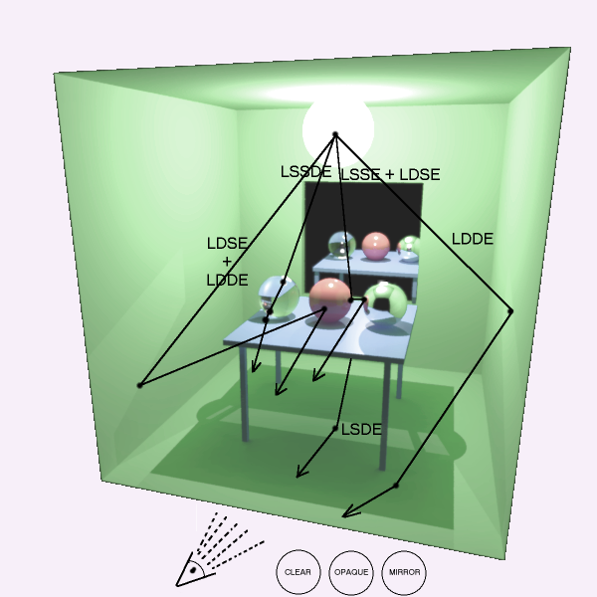
Path Notation
A path is written as a regular expression.
Examples:
  Ray tracing: LD[S*]E
  Radiosity: LD*E
Complete global illumination: L(D|S)*E

Slide 5
Bi-direction Ray Tracing
Also called two-pass ray tracing.
Note that the Monte Carlo technique is not involved.
The concept of “caching illumination” (as a mean of communication between two passes.) -- After the first pass, illumination maps are stored (cached) on diffuse surfaces.

Slide 6
Multi-pass Methods
Note: don’t confuse “multi-pass” with “bi-directional” or the multiple random samples in Monte Carlo methods.
LS*DS*E is included in bi-directional ray tracing.
How about the interaction between two diffuse surfaces? (radiosity déjà vu?)

Slide 7
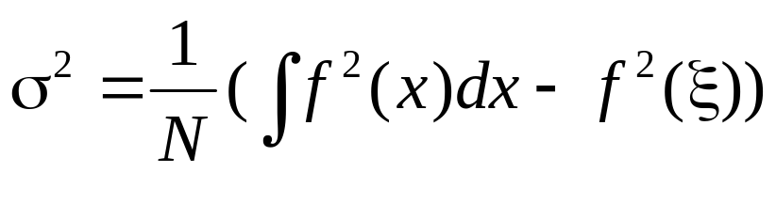
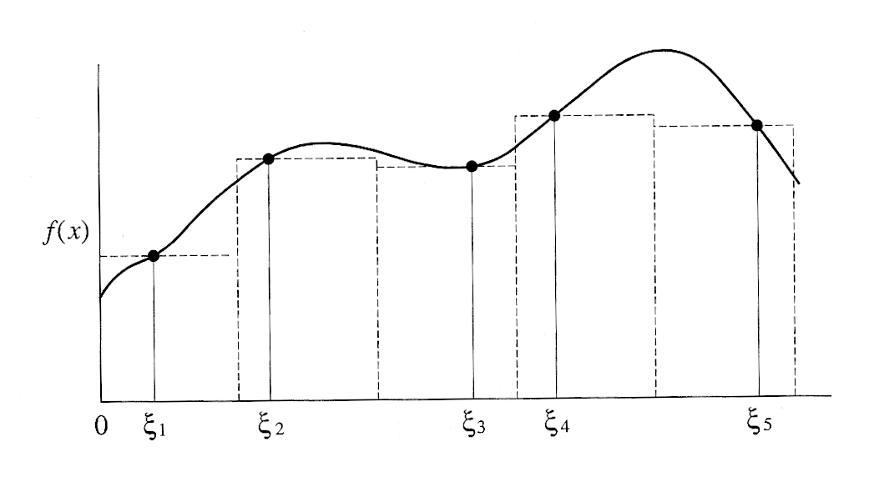
Monte Carlo Integration
Estimate the integral of f(x) by taking random samples ξ and evaluate f(ξ).
Variance of the estimate decreases with the number of samples taken (N):

Slide 8

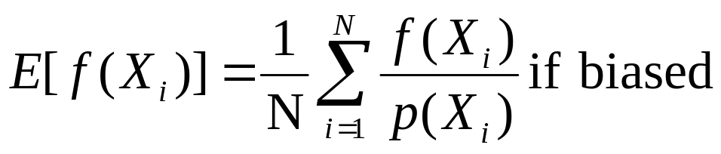
Biased Distribution
What if the probability distribution (p(x)) of the samples is not uniform?
Example:
  What is the expected value of a flawless dice?
  What if the dice is flawed and the number 6 appears twice as often as the other numbers?
  How to fix it to get the same expected value?

Slide 9
Example – Throwing a Dice
How to estimate the average of the following if we are only allowed to pick one Xi?
What if the dice is biased toward larger numbers?
f(Xi)
Xi

Slide 10
Exercise
Assuming a fair dice.
If we render an image, the pixel values may look like: 0, 0, 0, 6, 0, 0, ...
p(Xi)
f(Xi)
Xi
Xi

Slide 11
Exercise
Assuming a dice can only produce 4,5,6.
If we render an image, the pixel values may look like: 0, 3, 0, 0, 0, 3, ...
Note that pdf(Xi)=2 for Xi=4,5,6
p(Xi)
f(Xi)
Xi
Xi

Slide 12
Exercise
Assuming a dice that is stuck at 6.
If we render an image, the pixel values may look like: 1, 1, 1, 1, 1, 1, ...
pdf(6)=6 and pdf(Xi)=0 if Xi=1..5
p(Xi)
f(Xi)
Xi
Xi

Slide 13
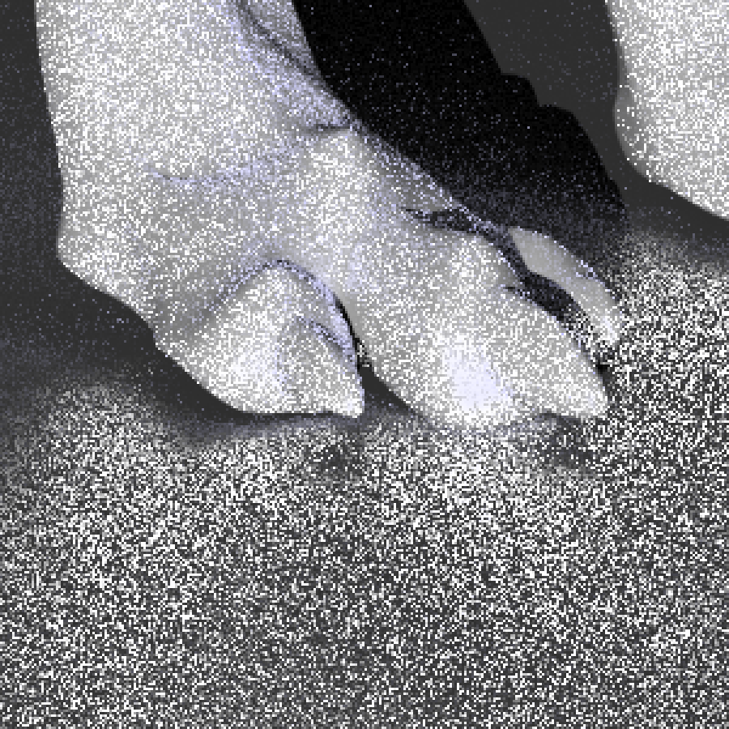
Noise in Rendered Images
The variance (in estimation of the integral) shows up as noise in the rendered images.

Slide 14
Importance Sampling
One way to reduce the variance (with a fixed number of samples) is to use more samples in more “important” parts.
Brighter illumination tends to be more important.
More detail in Veach’s thesis and his “Metropolis Light Transport” paper.

Slide 15
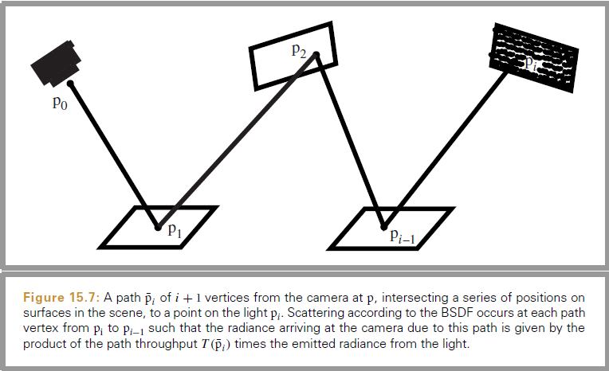
Path Tracing
See Pharr’s PBRT 2nd Ed. 15.3

Slide 16
Monte Carlo Path Tracing
Apply the Monte Carlo techniques to solve the integral in the rendering equation.
Questions are:
  What is the cost?
  How to reduce the variance (noise)?

Slide 17
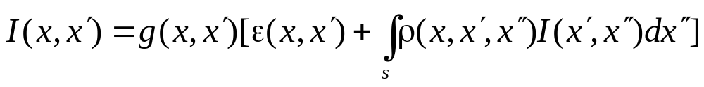
Rendering Equation
g() is the “visibility” function
ρ() is related to BRDF:
From Watt’s p.277

Slide 18
How to Solve It?
We must have:
  ε(): model of the light emitted
  ρ(): BRDF for each surface
  g(): method to evaluate visibility
Integral evaluation →Monte Carlo
Recursive equation → Ray Tracing

Slide 19
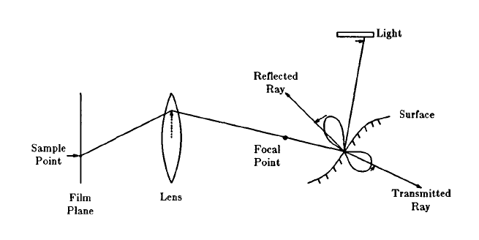
Typical Distributed Ray Path

Slide 20
Integrals
In rendering equation:
  Reflection and transmission.
  Visibility
  Light source
In image formation (camera)
  Pixel
  Aperture
  Time
  Wavelength

Slide 21
Effects
By distributing samples in each integral, we get different effects:
  Reflection and transmission → blurred
  Visibility → fog or smoke
  Light source → penumbras and soft shadow
In image formation (camera)
  Pixel → anialiasing
  Aperture → depth of field
  Time → motion blur
  Wavelength → dispersion

Slide 22
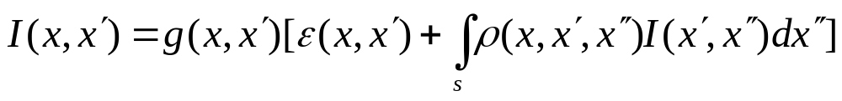
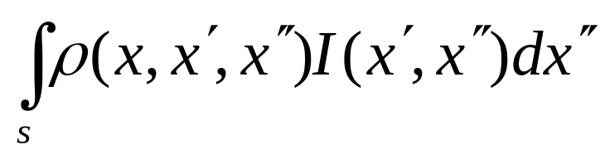
Integral of BRDF and Light
Rendering Equation (revisted)
Ignoring emitted light and occlusion, we still have an expensive integral:
Let f(Xi)=ρ (…) I (…) and evaluate its integral with Monte Carlo methods.

Slide 23
Integral of BRDF and Light
Let f(Xi)=ρ (…) I (…) and evaluate its integral.
Case1: a diffuse surface and a few area lights
Case2: a specular surface and environment lighting
Uniform sampling isn’t efficient in both cases. Why?
ρ (…)
Ι (…)

Slide 24
Can Importance Sampling Cure Them All?
Consider these two example:
  How to handle diffuse reflection?
  How to handle large area light source?
More in Veach’s thesis (especially Figure 9.2)
  Sampling BRDF vs. sampling light sources

Slide 25
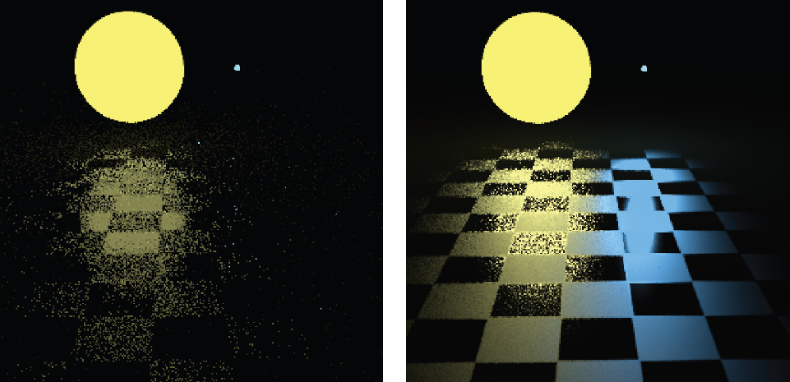
Multiple Importance Sampling
See Pharr’s PBRT 2nd Ed. 14.4
(a) sampling the surface reflectance distribution
(b) sampling the area light source

Slide 26
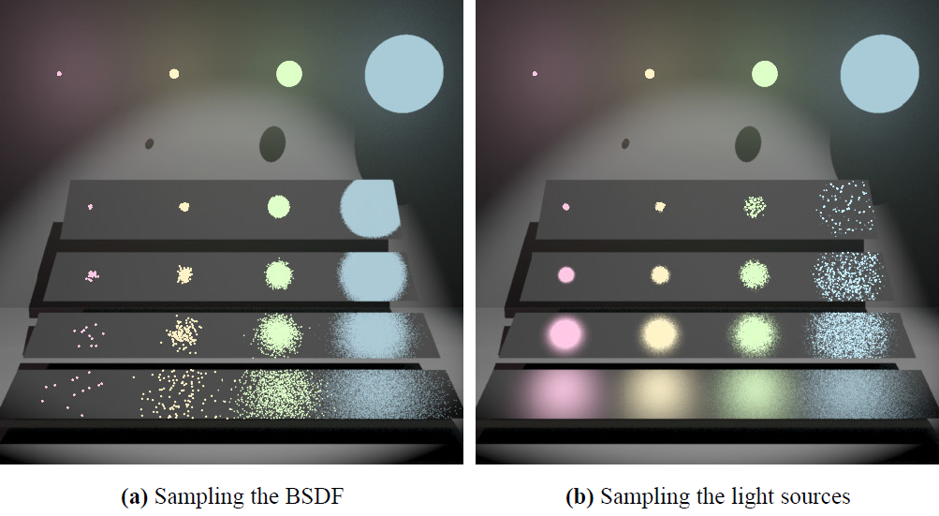
Source: Eric Veach, “Robust Monte Carlo Methods for Light Transport Simulation” Page 255, Figure 9.2.
Ph.D. Thesis, Stanford University

Slide 27
Summary
Monte Carlo path (ray) tracing is an elegant solution for including diffuse and glossy surfaces.
To improve efficiency, we have (at least) two weapons:
  Importance sampling
  Caching illumination

Slide 28
Exercises (Food for Thought)
Can the multi-pass method (i.e., light-ray tracing, radiosity, then eye-ray tracing) replace the Monte Carlo path tracing approach? (Hint: glossy?)
What are the differences between Cook’s distributed ray tracing and a complete Monte Carlo path tracing?

Slide 29
References
Robust Monte Carlo Methods for Light Transport Simulation, Eric Veach, Ph.D. dissertation, Stanford University,1997
Advanced (quasi) Monte Carlo methods for image synthesis in SIGGRAPH 2012 Courses.
Pharr’s chapters 14-16.
Watt’s Ch.10 (especially 10.1.3, and 10.4 to 10.9)

Slide 30
The End

